Slide 1
Cellular automata for sandpiles
Malena Held, Samuel Germer

Slide 2
Introduction
1/f noise present in self-organized critical systems
small perturbations lead to states of instability avalanches
properties of the systems are independent of initial configuration
Project:
Simulate sandpiles with different starting conditions
Look at distributions of system avalanche properties
Calculate characteristic coefficients

Slide 3
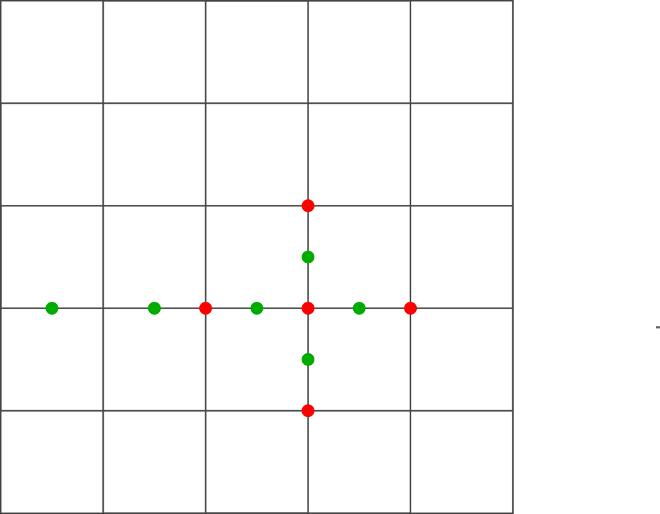
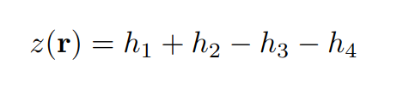
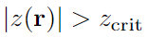
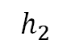
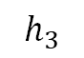
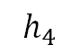
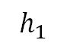
Cellular automaton
0
N
d-dimensional grid
Grid size N
Assign integer value z(r) to each point
Average slope:
Relax grid if:
0
$$h_{3}$$
$$h_{1}$$
$$h_{4}$$
$$h_{2}$$
N
Christensen et al. (1991)
Notes:
M

Slide 4
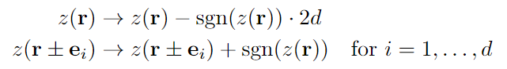
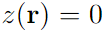
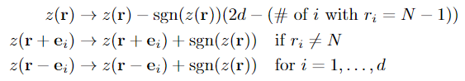
Relaxation and boundary conditions
0
N
Relaxation:
Closed boundaries: on boundaries
Open boundaries:
on boundaries, where
0
+1
+1
-4
+1
+1
N
Christensen et al. (1991)
Notes:
M

Slide 5
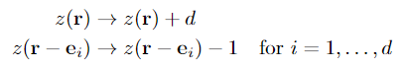
Perturbation mechanism
0
N
Random perturbations of the system
Conservative perturbation:
0
-1
+1
-1
+1
+2
N
Christensen et al. (1991)
Notes:
M

Slide 6
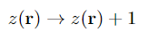
Perturbation mechanism
0
N
Random perturbations of the system
Conservative perturbation:
Non conservative perturbation:
0
+1
+1
+1
+1
N
Christensen et al. (1991)
Notes:
M

Slide 7
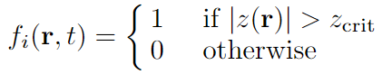
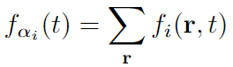
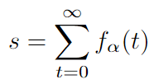
Derived quantities - I
Indicator function:
Instantaneous dissipation rate:
Total dissipation
Christensen et al. (1991)
Notes:
M

Slide 8
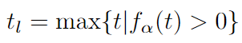
Derived quantities - II
Lifetime:
Linear spatial size:
Christensen et al. (1991)

Slide 9
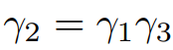
Distributions
Scaling relations:
Conditional expectation values:
Also:
Christensen et al. (1991)
Notes:
M

Slide 10
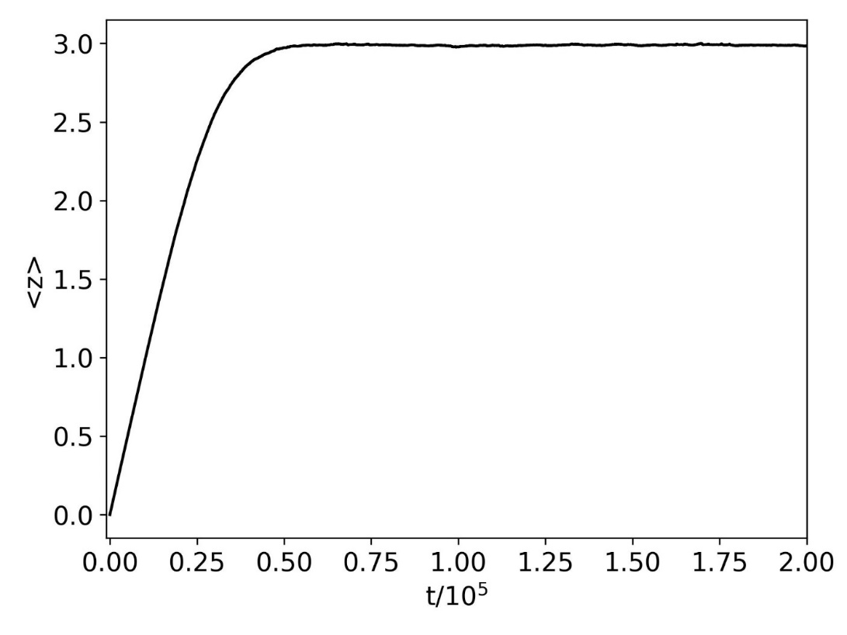
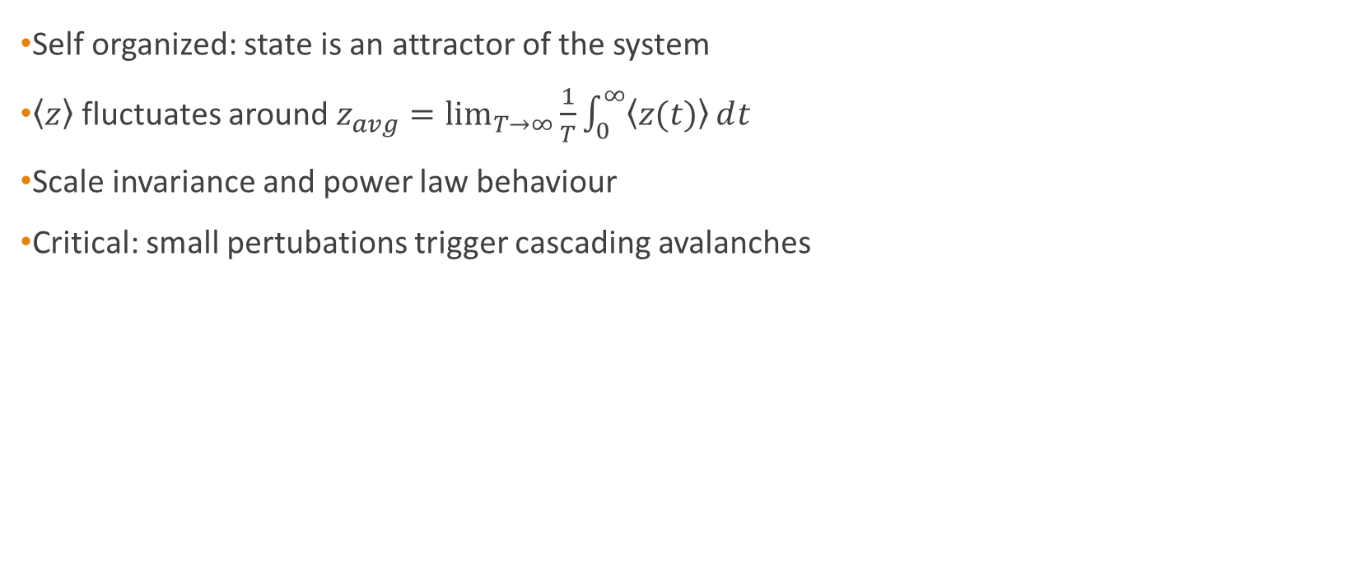
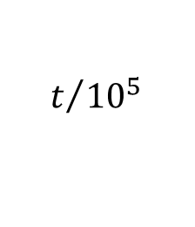
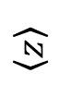
Steady state (crtitical state)
Self organized: state is an attractor of the system
$\left\langle z\right\rangle$ fluctuates around $z_{avg}=\lim_{T→∞}{\frac{1}{T}\int_{0}^{∞}{\left\langle z(t)\right\rangle ⅆt}}$
Scale invariance and power law behaviour
Critical: small pertubations trigger cascading avalanches
$$\left\langle z\right\rangle$$
$$t/{{10}^{5}}$$
Notes:
S

Slide 11
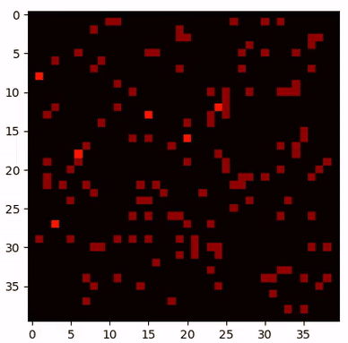
Steady state (crtitical state)
2 dimensions
40x40 lattice
Critical value of 4
Notes:
S

Slide 12
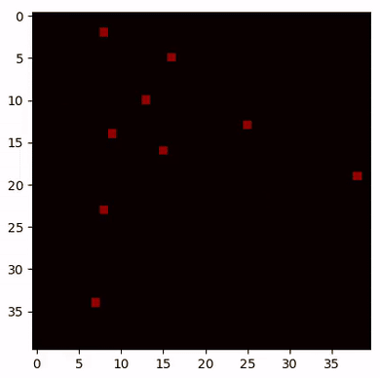
Steady state (crtitical state)
2 dimensions
40x40 lattice
Critical value of 4
Notes:
S

Slide 13
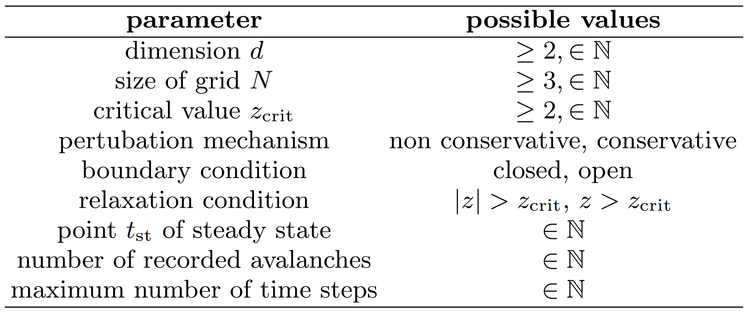
Algorithm
Notes:
S

Slide 14

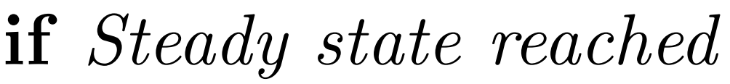
Algorithm
Notes:
S

Slide 15
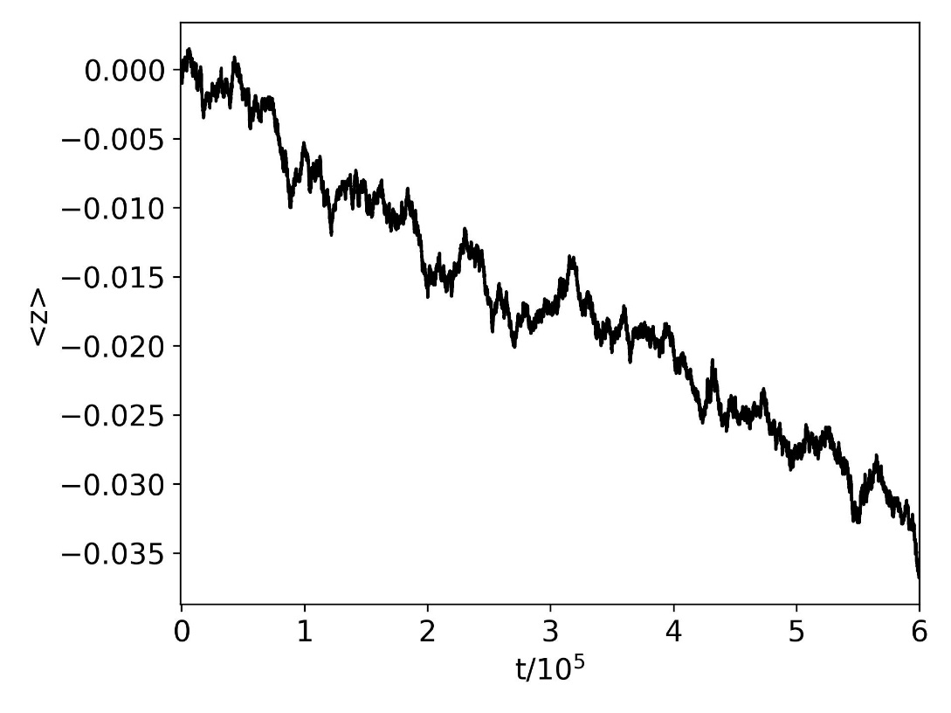
Parameter selection
Non conservative
Closed boundary
Conservative
Closed boundary
Non conservative
Closed boundary
Non conservative
Closed boundary
Notes:
S

Slide 16
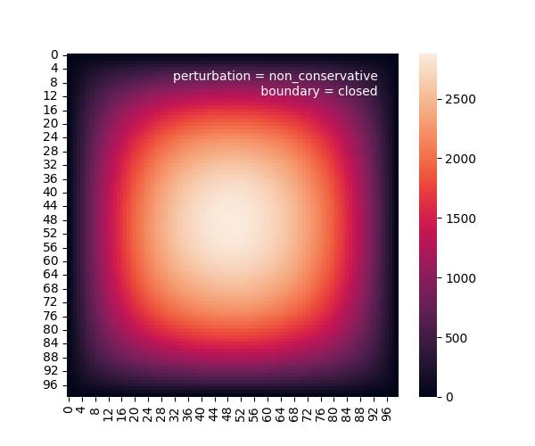
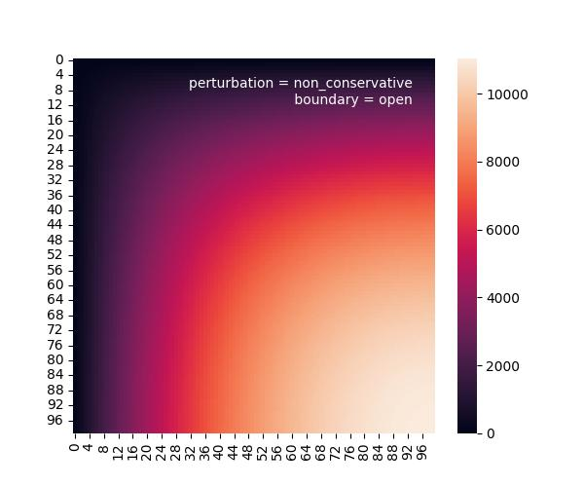
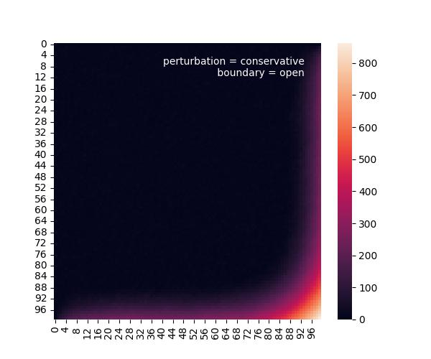
Parameter selection
Non conservative
Closed boundary
Non conservative
Open boundary
Conservative
Open boundary
Non conservative
Closed boundary
Non conservative
Closed boundary
Non conservative
Closed boundary
Notes:
S

Slide 17
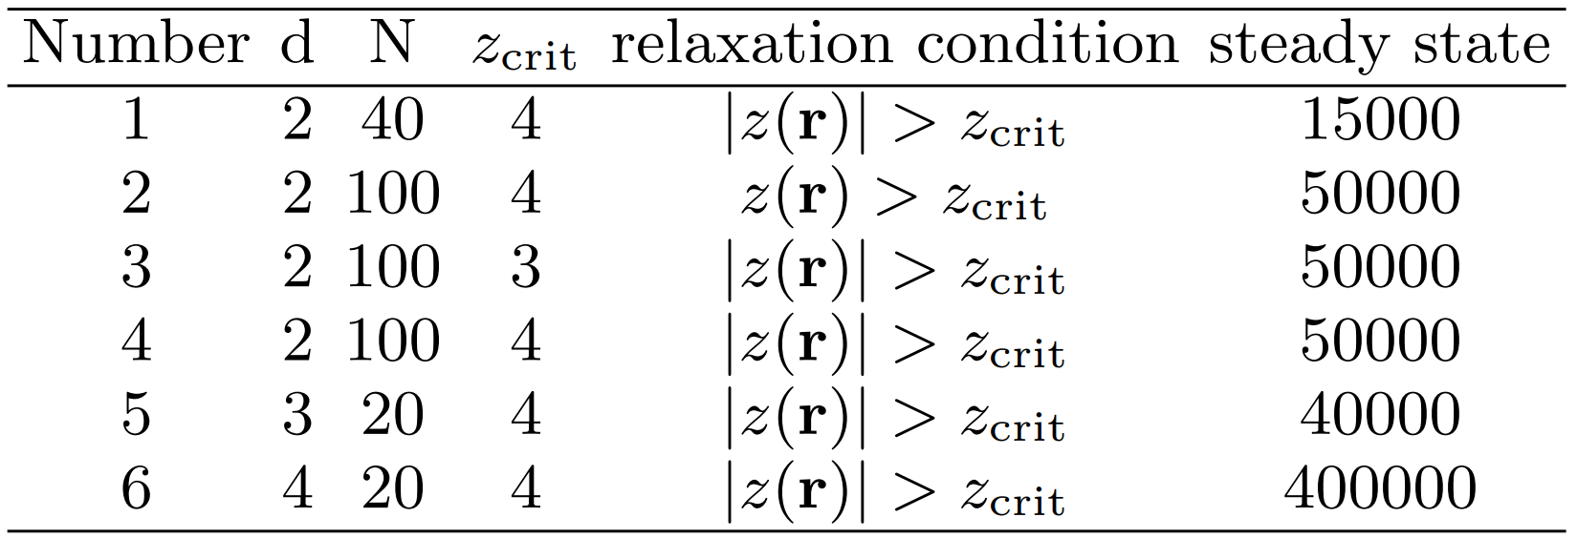

Simulations
Notes:
S

Slide 18
Simulations
Independent of model parameter
Notes:
S

Slide 19
Simulations
Dependency on dimension
Notes:
S

Slide 20
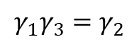
Results
$$γ_{1}γ_{3}=γ_{2}$$
For 2, 3 and 4 dimensions

Slide 21
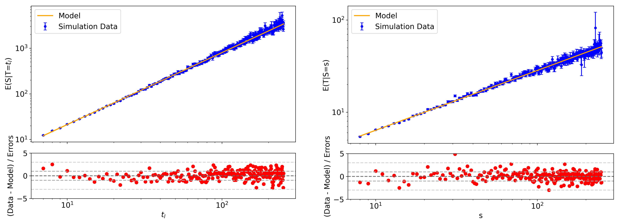
Results (2d)

Slide 22
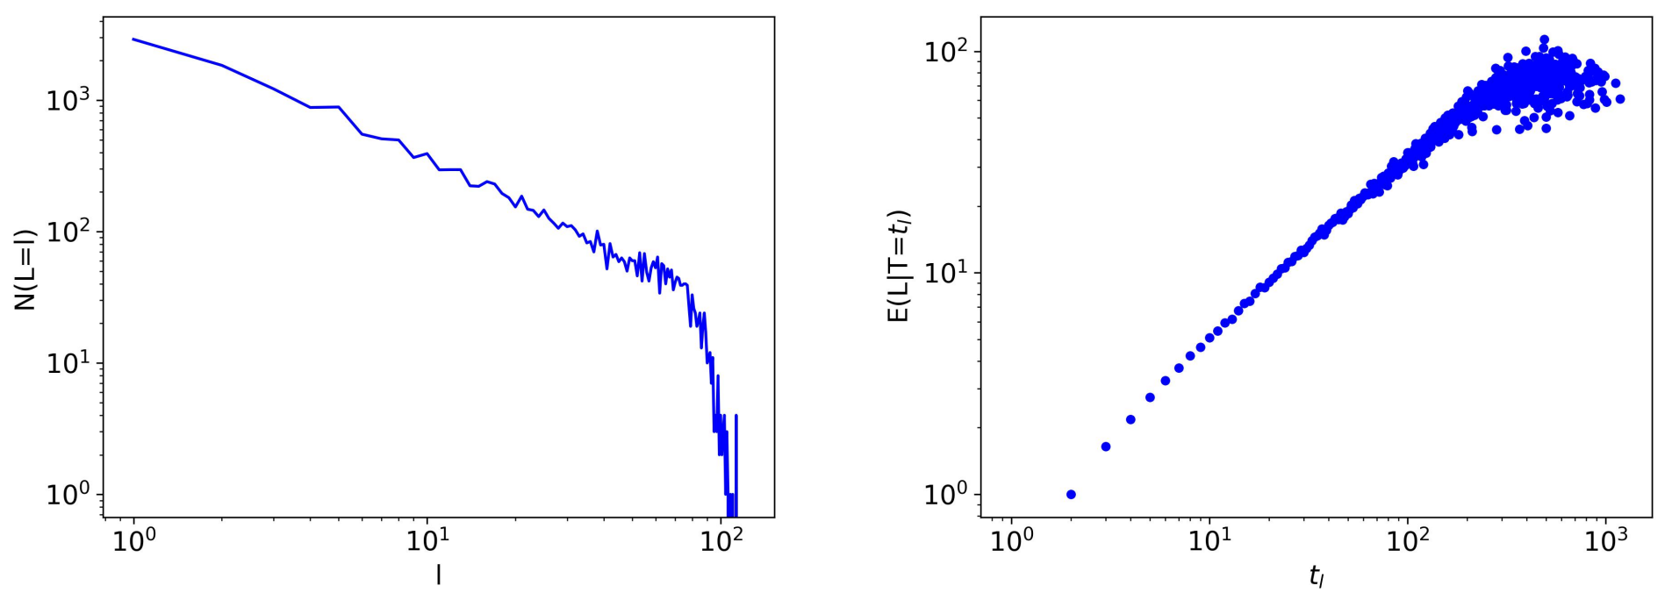
Systematic uncertainties
Finite grid size
Notes:
S

Slide 23
Systematic uncertainties
Finite grid size
Discrete lattice
Notes:
S

Slide 24
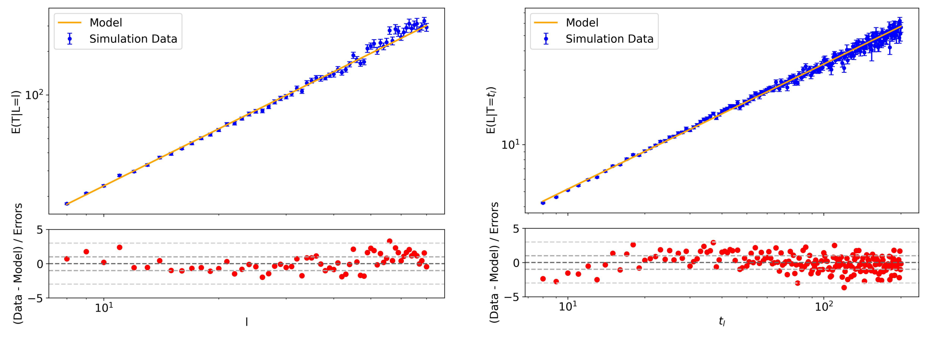
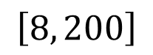
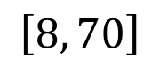
Systematic uncertainties
$$\left[8, 70\right]$$
$$\left[8, 200\right]$$

Slide 25
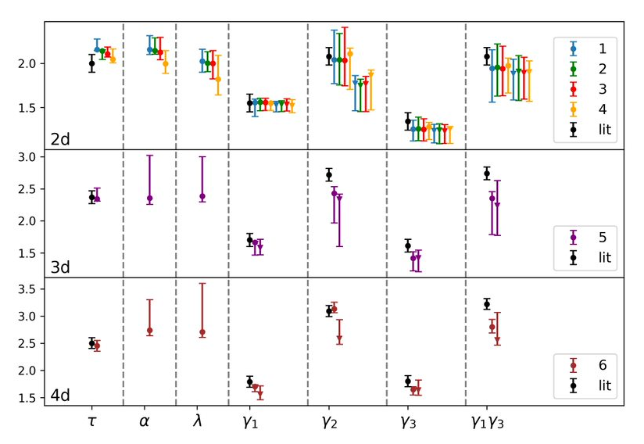
Results
Reciprocal relation validated
Systematic deviation from literature
Coefficients independent of scale
Coefficients dependent on dimensions
Literature values from Christensen et al. (1991)

Slide 26
Summary
behavior of sandpiles using cellular automata
Determined critical exponents, verified reciprocal relationsships
Results are consistent with literature when considering systematic uncertainties
System automatically evolves into critical state
Critical exponents only depend on dimension of the system

Slide 27
Outlook
1) Reduce systematic uncertainties:
Use lattices of larger size N, record more avalanches
Systematically determine range where discreteness plays a role
2) Power spectrum:
Proposed: indenpendent of dimension
Data Analysis and Parameter optimization needs to be done

Slide 28
